Slide 1
Chapter 5: Blood flow in the lungs and Physiology one long ventilation
By Eyayalem M. (Assistant. Professor Apri, 2025)

Slide 2
Blood flow in the lungs and Physiology one long ventilation
The blood flow through the lungs is essentially equal to the cardiac output.
The flow is able to accommodate at least a five fold increase in cardiac out put after developing so great a pulmonary hydrostatic pressure as to result in pulmonary edema.

Slide 3
Physiology of the LDP
- As the total flow increases, the pulmonary vascular resistance decreases for two Reasons
a) Because of the recruitment or opening of
previously closed vessels, thus ↑ing the
numbers of open vessels.
b) Because of the distension of already open
vessels, thus enlarging these opened vessels.
In the upright human lung, blood flow decrease from the bottom to the top, reaching very low values at the apex as compared to the base

Slide 4
Ventilation :Perfusion Ratio
the majority of blood flow is distributed to the gravity-dependent part of the lung.
During a spontaneous breath, the largest portion of the tidal volume also reaches the gravity-dependent part of the lung.

Slide 5
Ventilation :Perfusion Ratio
The nondependent area of the lung receives a lower proportion of both ventilation and perfusion, and
Dependent lung receives greater proportions of ventilation and perfusion.

Slide 6
Ventilation :Perfusion Ratio
ventilation and perfusion are not matched perfectly, and various V_{A}/Q ratios result throughout the lung.
The ideal V_{A}/Q ratio of 1 is believed to occur at approximately the level of the third rib.
Above this level, ventilation occurs slightly in excess of perfusion, whereas below the third rib the V_{A}/Q ratio becomes less than 1. (look at the Fig ).

Slide 7
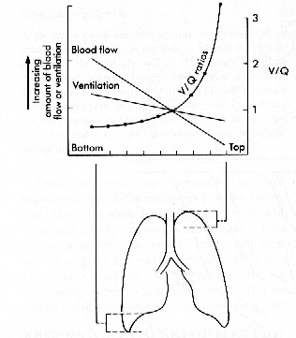
the relation of ventilation, blood flow and V/Q ratios between bottom and apical parts of lung

Slide 8
Physiology of the LDP
- Posture and exercise affect this distribution.
In the supine position,
- the distribution is similar; blood flow in the posterior regions of the lung (analogous to the bottom) exceeds flow in the anterior regions (analogous to the top).
On mild exercise blood flow through all areas of the lung increases so that regional differences become less.

Slide 9
Physiology of the LDP
For every centimeter of vertical distance up the lungs, the decrease in pulmonary artery
pressure is approximately 1 cm H₂O.
End expiration alveolar pressure is normally close to atmospheric pressure.
At least in the upright posture, a region may exist at the top of the lung (zone 1) where the pulmonary arterial pressure is less than alveolar pressure (PA >P_{Pa}) .

Slide 10
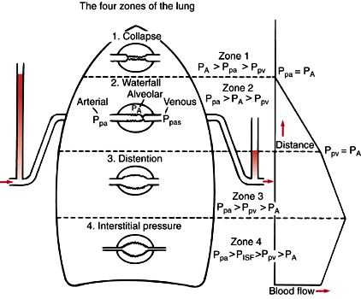
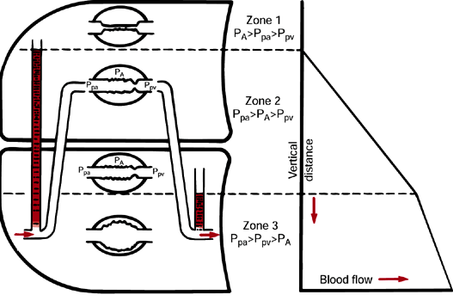
Physiology of the LDP
Upright position
LDP, lateral decubitus

Slide 11
Physiology of the LDP
Under normal conditions such condition does not occur when the pulmonary artery pressure is high enough to maintain perfusion to the top of the lung.
- Zone 1. May occur, however, if arterial pressure is reduced by severe hemorrhage or if alveolar pressure is raised by positive pressure ventilation

Slide 12
Physiology of the LDP
- Further down the lung (zone. 2) the hydrostatic pressure is greater than at the top of the lung. Pulmonary artery Pressure now exceeds alveolar pressure (P_{Pa} > P_{A}), which in turn exceeds venous pressure
Under these conditions, blood flow is determined by the difference between arterial and alveolar pressure and not by the usual arterial and venous difference, this has been called the starting resistor or water fall effect)

Slide 13
Physiology of the LDP
the blood flow in zone 3 is determined by the usual arterial -venous pressure difference
(P_{Pa} > P_{PV}).
The pressure immediately outside the vessels (i.e the pleural pressure) becomes only slightly less negative in more dependent lung regions, but the arterial - venous pressure with in the vessels is increasing standing down the zone

Slide 14
Physiology of the LDP
In the most dependent regions of the lung fluid may transudat out of the pulmonary Capillaries and veins into the pulmonary interstitial compartment, with conversion of the normally present negative pressure to a positive interstitial pressure.
The interstitial pressure (P_{I}) increases to compress and reduce the diameter of the vessels (zone – 3&4) and this may lead to decrease regional blood flow

Slide 15
Physiology of the LDP
Thoracic surgery is undertaken in the lateral position &the terms
Non-dependent (operative collapsed lung) and
Dependent lung ( continuously ventilated normal lung )

Slide 16
The effect of LDP ON V/Q
1-Lateral position, awake, breathing spontaneously
In the lateral decubitus position, the distribution of blood flow and ventilation is similar to that in the upright position and is gravity dependent
Blood flow and ventilation to the dependent lung are significantly greater than to the nondependent lung

Slide 17
The effect of LDP ON V/Q
Good V/Q (Ventilation perfusion) matching at the level of the dependent lung results in adequate oxygenation in the awake patient breathing spontaneously.
There are two important concepts affect the distribution of blood in LDP as compared to upright.

Slide 18
The effect of LDP ON V/Q
the vertical hydrostatic gradient is smaller in the lateral as compared to the upright position; therefore, zone 1 is usually less extended.
In regard to ventilation, the dependent hemi diaphragm is pushed higher in to the chest by the abdominal contents as compared with the nondependent lung hemi diaphragm.

Slide 19
The effect of LDP ON V/Q
During spontaneous ventilation, the conserved ability of the dependent diaphragm to contract will result inadequate distribution of tidal volume to the dependent lung.
Because most of the perfusion is to the dependent lung, the V/Q matching in this position is maintained similar to that in the upright position.

Slide 20
The effect of LDP ON V/Q
So
in LDP there is less of Zone 1& more of Zone 2 &3.
The decrease in zone 1 reduces the extent of patient’s dead space.

Slide 21
The effect of LDP ON V/Q
Blood distribution to each lung
In the up right position the blood distribution to the lung is splint :-
60% of CO goes to right lung(has 3 lobs) &
40%- of CO goes to left lung (has 2 lobs)
In right LDP the split is approximately
65% to the right dependent lung&
35 %to the left non dependent lung.

Slide 22
The effect of LDP ON V/Q
In left LDP
left dependent lung receives 55% &
the right lung receives 45%.
Average blood flow in LDP is
60% flow to dependent lung
40% flow to non dependent lung

Slide 23
The effect of LDP ON V/Q
2-Lateral position, awake, breathing spontaneously chest open
Controlled positive pressure ventilation is the most common way to provide adequate ventilation and ensure gas exchange in an open chest situation.
Frequently thoracoscopy is performed using intercostals blocks with the patient breathing spontaneously to allow proper lung examination.

Slide 24
The effect of LDP ON V/Q
Two complications can arise from the patient breathing spontaneously with an open chest.
These are
Mediastinal shift
Paradoxical breathing

Slide 25
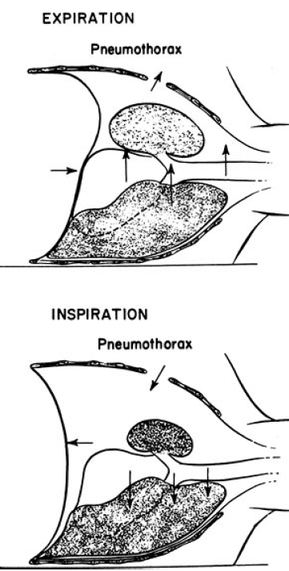
The effect of LDP ON V/Q
Mediastinal shift in the spontaneously breathing, open-chested patient in the lateral decubitus position.
During inspiration, negative pressure in the intact hemi thorax causes the mediastinum to move downward.
During expiration, relative positive pressure in the intact hemithorax causes the mediastinum to move upward.

Slide 26
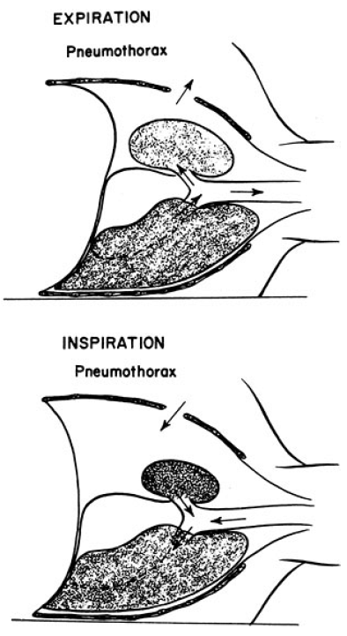
Paradoxical respiration in the spontaneously breathing, open-chested patient in the lateral decubitus position.
During inspiration, movement of gas from the exposed lung into the intact lung and movement of air from the environment into the open hemithorax cause collapse of the exposed lung.
During expiration, the reverse occurs, and the exposed lung expands.

Slide 27
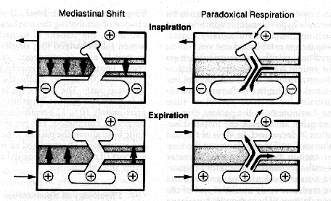
The effect of LDP ON V/Q

Slide 28
The effect of LDP ON V/Q
3-Lateral position, anesthetized, breathing spontaneously, chest closed
The induction of general anesthesia does not cause significant change in the distribution of blood flow but has an important impact on the distribution of ventilation.
Most of the tidal volume enters the nondependent lung, and these results in a significant V/Q mismatch.

Slide 29
The effect of LDP ON V/Q
Induction of GA causes a reduction in the volumes of both lungs secondary to a reduction in FRC.
Any reduction in volume in the dependent lung is of a greater magnitude than that in the nondependent lung for several reasons.

Slide 30
Physiology of the LDP
The reasons are
The cephalad displacement of the dependent diaphragm by the abdominal contents is more pronounced and is increased by paralysis.
The mediastinal structures pressing on the dependent lung and/or poor positioning of the dependent side of the operating table prevent the lung from expanding properly.

Slide 31
The effect of LDP ON V/Q
4-Lateral position, anesthetized, breathing spontaneously, chest open
Opening the chest has little impact on the distribution of perfusion.however,the upper lung is now no longer restricted by the chest wall and is free to expand, resulting in a further increase in V/Q mismatch as the nondependent lung is preferentially ventilated owing to a new increased compliance.

Slide 32
The effect of LDP ON V/Q
5-Lateralposition,anesthetized,paralyzed,chest open.
During paralysis, and positive-pressure ventilation, diaphragmatic displacement is maximal over the nondependent lung, where there is the least amount of resistance to diaphragmatic movement caused by the abdominal contents, this further compromises the ventilation to the dependent lung and increases the V/Q Mismatch.

Slide 33
The effect of LDP ON V/Q
6-one lung ventilation, anesthetized, paralyzed, chest open
During two lung ventilation in the lateral position, the mean blood flow to the ND lung is assumed to be 40% of the cardiac out put, and 60%of the cardiac out put goes to the D lung.

Slide 34
The effect of LDP ON V/Q
shunt in the lateral position is 10%of the cardiac out put &is equally divided as 5% in each lung.
This is due to drainages from
Thebesian veins of the heart
The pulmonary bronchial veins
Mediastinal and pleural veins

Slide 35
The effect of LDP ON V/Q
therefore, the average percentage of cardiac out put participating in gas exchange is 35% in the non dependent lung and 55% in the dependent lung.
One lung ventilation creates an obligatory right to left transpulmonary shunt through the non ventilated, non dependent lung, since the V/Q ratio of that lung is zero. In theory, an additional 35% should be added to the total shunt during one lung ventilation. however, assuming active hypoxic pulmonary vasoconstriction, blood flow to the nondependent hypoxic lung will be reduced by 50% and therefore will be 35/2 = 17.5%.

Slide 36
The effect of LDP ON V/Q
To this must be added 5%, which is the obligatory shunt through the non-dependent lung, will therefore be 22.5%.
Together with the 5% shunt in the dependent lung, total shunt during one lung ventilation is 22.5 + 5 = 27.5%, this results in Pao₂ of approximately 150 mmHg.

Slide 37
Thank you!!! Melat & Meron

